Slide 1

Nepal’s First Online Payment Gateway
- Group One
Nov 23, 2018

Slide 2


Members of Group One
Bishal Khadka
Khum Khatri
Manish Tuladhar
Rabin Bhandari

Slide 3
Contents to be discussed
Introduction
Main motto
eSewa Services
eSewa Company Overview
Benefits
Issues
Future plans

Slide 4
Who are eSewa?
eSewa is a mobile money account. It is a digital wallet from where customers can pay, send and receive money from their mobile phone and internet, instantly.
It is in operation since 2009 and has recently been licensed by Nepal Rastra Bank as Payment Service Provider.
Developed by f1soft company.
Brings users, agents, merchants, BFIS together within a single roof.
Available in through app store, play store and web.

Slide 5
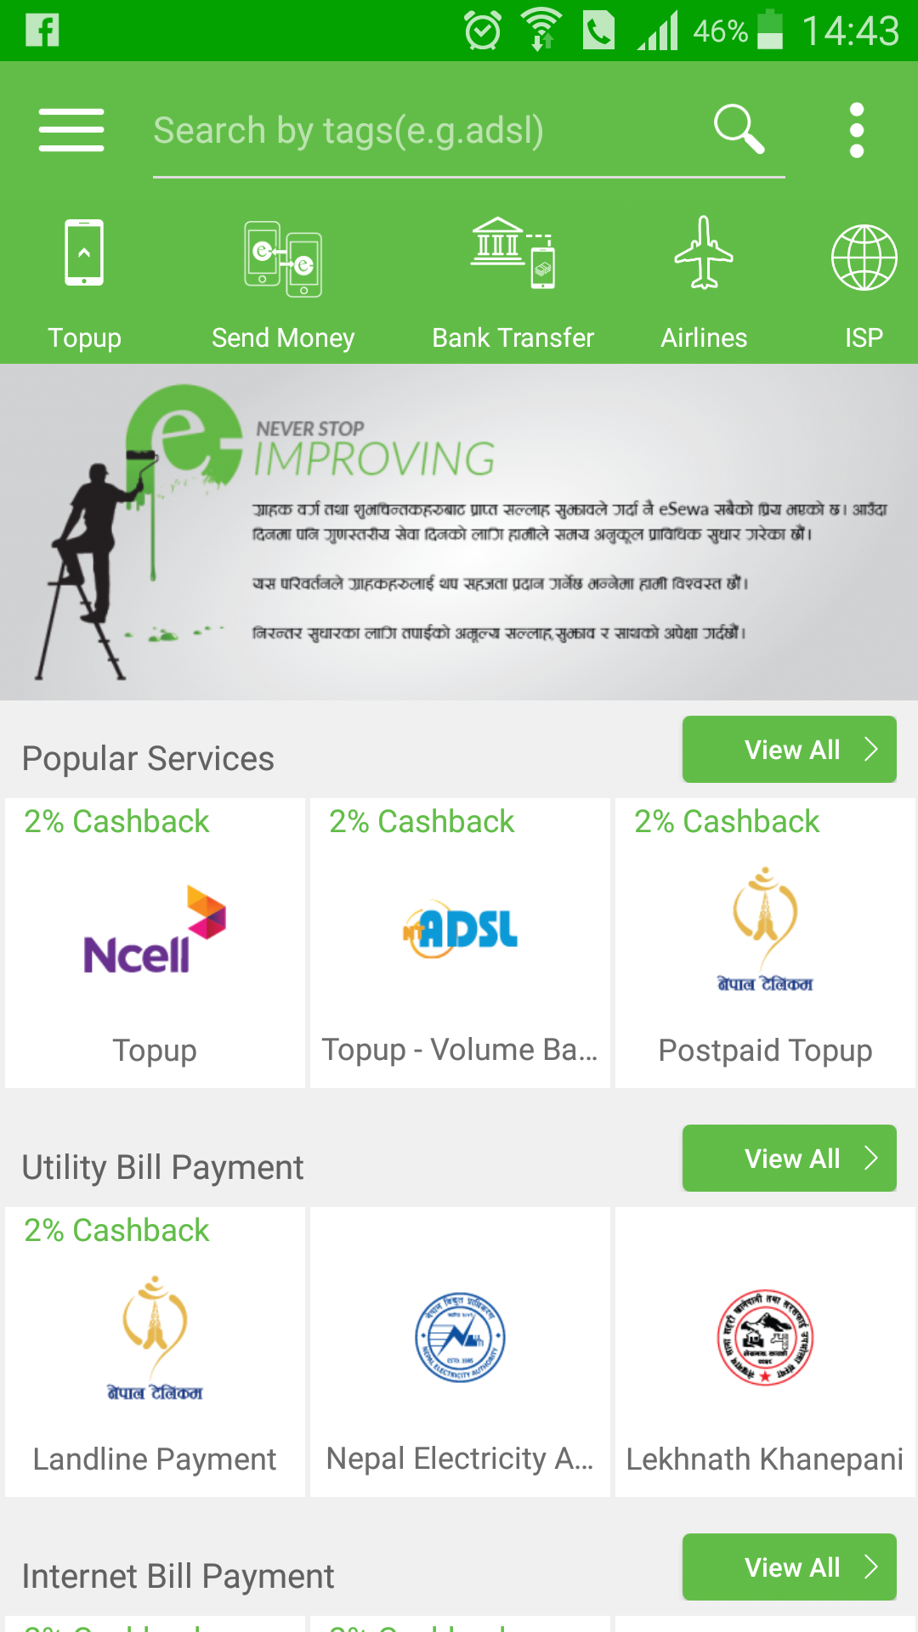
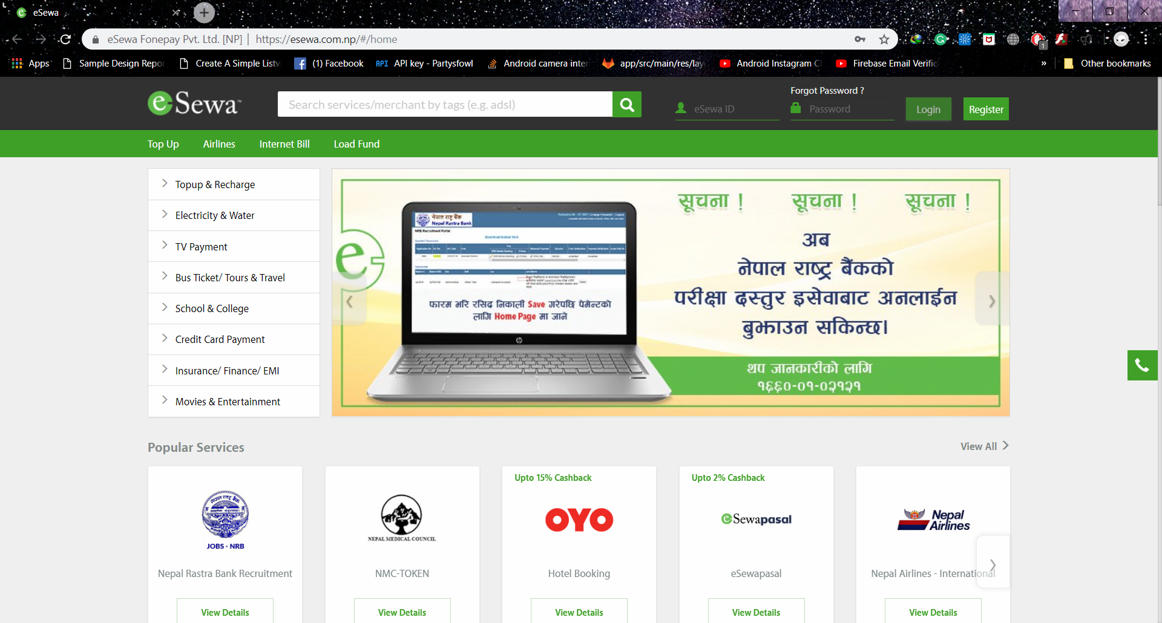
eSewa Platforms
eSewa Website and Mobile Application

Slide 6

Main Motto
Remove cash transaction and create trustworthy digital environment all over Nepal.

Slide 7
Company Overview
eSewa
Users
Agents
Merchants
BFIS

Slide 8
Services
Bank load Enables to load or transfer money from 49 different banks.
Bank to wallet Customers can withdraw money from bank to their digital wallet.
Merchant payment Users can pay bills such as NEA bill, internet bill, book bus tickets etc.
Withdraw Users can withdraw money from eSewa account.
Inter-Bank Fund Transfer (IBFT) Users can transfer money from one bank to another within 49 eSewa associate banks.

Slide 9
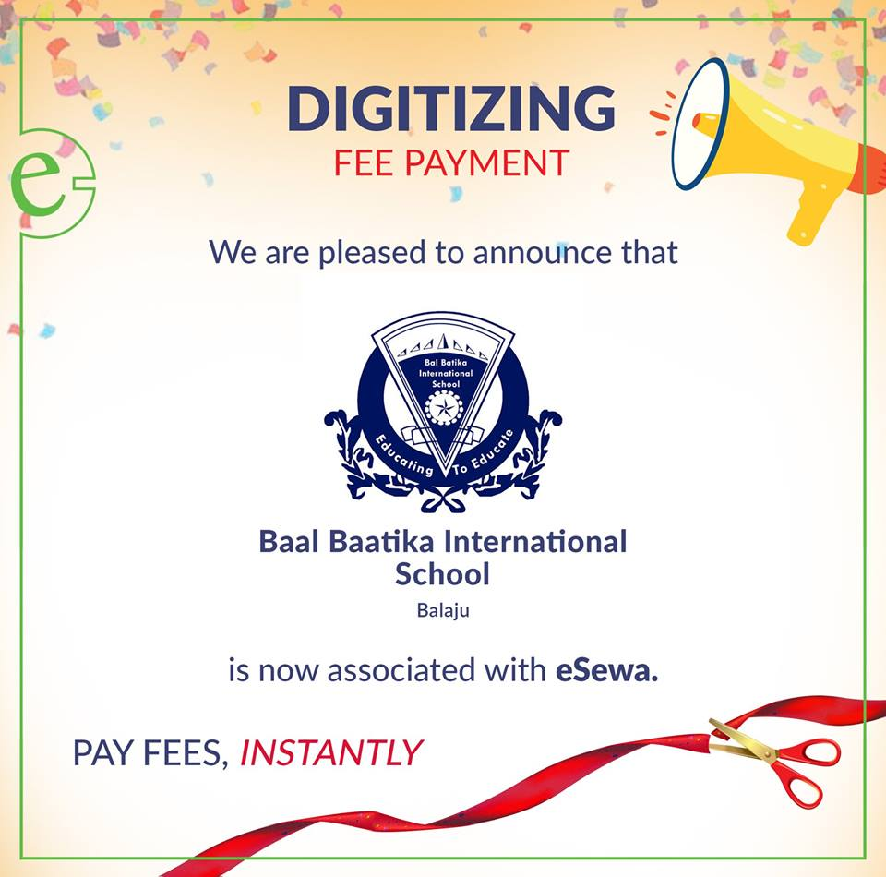
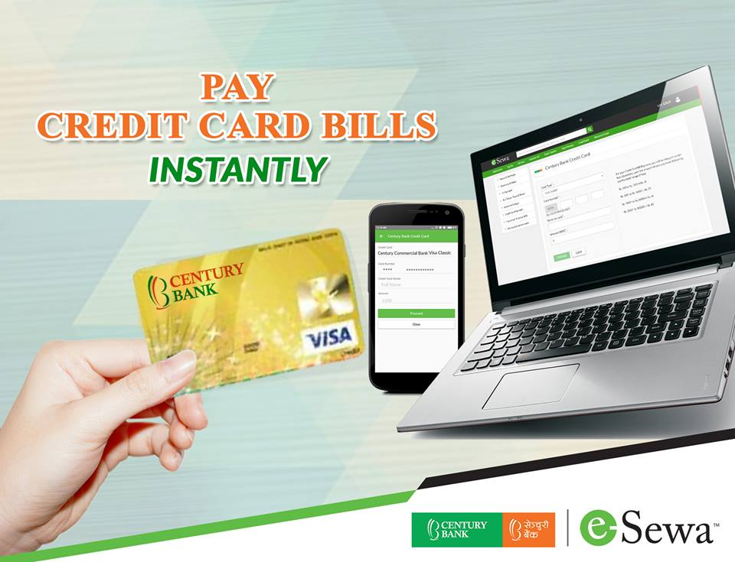

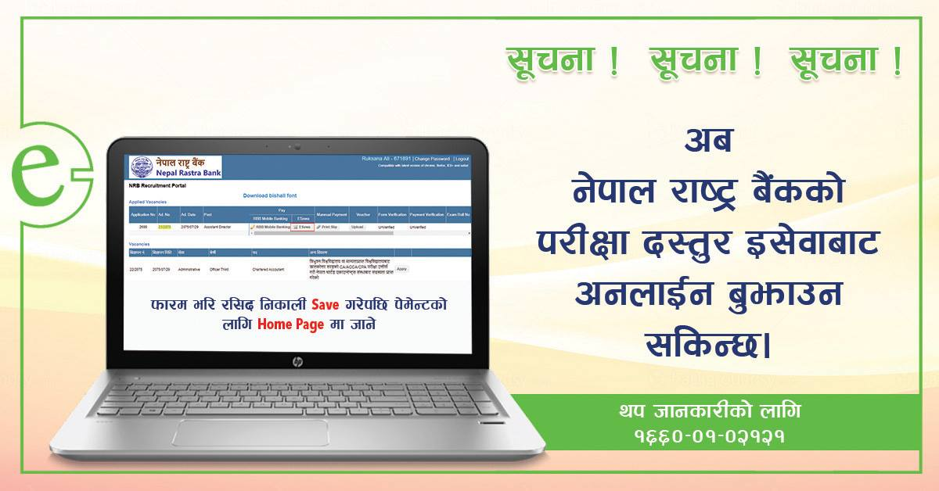


eSewa Ad Campaigns

Slide 10
Benefits
Merchant payment It allows different online payments such as NEA bill payment, worldlink, tour package, airways ticketing.
Online help Payments can be done from eSewa app and it’s more convenient to get details about different prices such as bus fares, internet bills and more.
Removes workload This enables hassle-free, secure and immediate payments from customers.
Straight up payment system We can pay school fees, electricity bills, phone recharge, money transfer within banks.

Slide 11
How eSewa deals with issues?
Operational Team
Main issues(banking)
Reconciliation daily (checking daily weather money is loaded or not )
Customer follow up
24 hours toll free
About 50 staff working daily for to give service and solve the problem.

Slide 12
Future plans
Digital 2020 To digitize Nepal by 20% within 2020 A.D.
Scan and pay with the help of QR code Users can scan and pay or recharge by scanning the QR code and send it to merchant’s eSewa account.
Adding new merchants
Esewa plans to add new merchants linked to different sectors like schools, hospitals and restaurants.

Slide 13


Slide 14


